Slide 1
Data Privacy: Introduction

Slide 2
Introduction
Data Science vs. Data Privacy
Quantity vs. Quality
Privacy-Respecting Data Science is Possible
Where is your data coming from?
Where is your data going?

Slide 3
Outline
Conceptions of Privacy
Privacy Principles
Informed Consent
Group Privacy
Summary

Slide 4
Conceptions of Privacy

Slide 5
Conceptions of Privacy
Individualistic vs. Collective vs. Social
Nothing to Hide (Solove)
Left Alone (Warren and Brandeis)

Slide 6
Conceptions of Privacy
Lifecycle of Data (Solove’s taxonomy)
Collection
Processing
Dissemination
Invasion

Slide 7
Conceptions of Privacy
Appropriate Flow (Nissenbaum’s Contextual Integrity Framework)
Information type
Transmission principle (identified vs. deidentified)
Information subject
Information sender
Information recipient

Slide 8

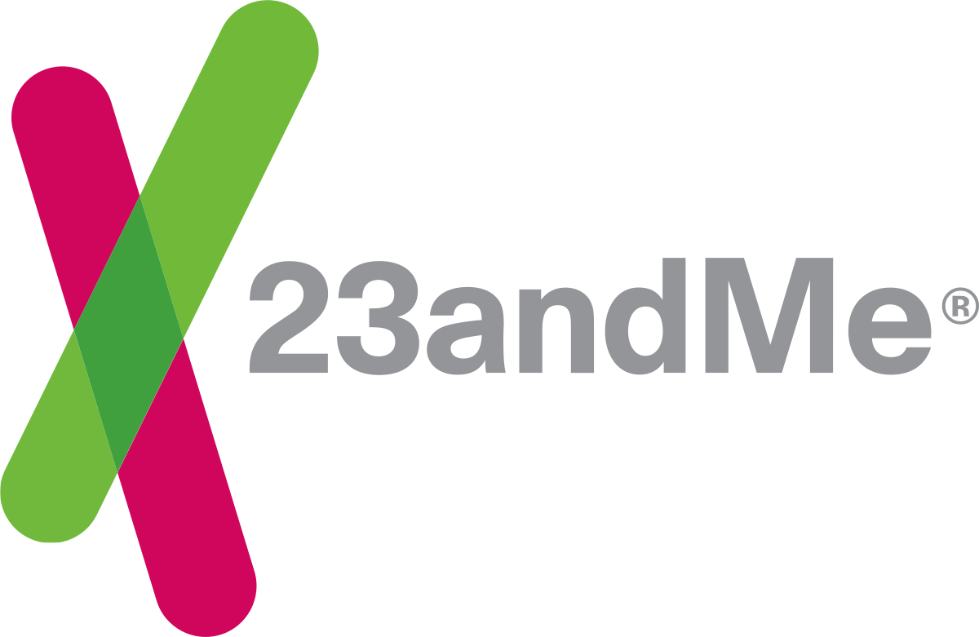

Conceptions of Privacy - Genetics
Individual vs. Collective→ Nothing to Hide
Privacy harms throughout lifecycle of data
Context

Slide 9
Privacy Principles

Slide 10
Privacy Principles
Fair Information Practice Principles
Transparency
Use limitation
Access and correction
Data quality
Security

Slide 11
Privacy Principles
The Belmont Report
Respect
Beneficence
Justice
→ IRB and Common Rule

Slide 12
Privacy Principles
Laws
U.S.
HIPAA, FERPA
Europe
GDPR
→ Brazil, Japan, California

Slide 13
Privacy Principles
Principles for the Big Data Era (Cate)
Collection Limitation
Data Quality
Purpose Specification
Use Limitation
Security Safeguards
Openness
Participation
Accountability

Slide 14
Privacy Principles - Genetics
Inconsistencies across time and context
FIPPS (1970s)
The Belmont Report (1979)
HIPAA (1996)
FERPA (1974)
GINA (2008)
GDPR (2016)
CCPA (2020)

Slide 15
Informed Consent

Slide 16
Informed Consent
FIPPs
Cognitive and Structural Issues (Solove)
Consent Desensitization (Schermer, Custers, and Hof)
Possible with volatility? Consenting to Professional Ethics? (Barocas and Nissenbaum)
Consent Dilemma (Solove)

Slide 17
Informed Consent - Genetics
Testing with an expectation about one disease...and get results about another
Distrust & Minority Groups

Slide 18
Group Privacy

Slide 19
Group Privacy
Dependencies (Barocas and Levy)
Tie-based
Similarity-based
Difference-based
Tyranny of the minority (Barocas and Nissenbaum 2014)
Stigmatized groups such as Alcoholics Anonymous (Helm)

Slide 20
Group Privacy - Genetics
Privacy Dependencies
Crime
Personalized Medical Treatment

Slide 21
Summary of Data Privacy

Slide 22
Summary
Does data science hate privacy?
Data Science vs. Data Privacy
Quantity vs. Quality
Privacy-Respecting Data Science is Possible
Where is your data coming from?
Where is your data going?

